Slide 1



World Cultural Tourism Association
World Tourism Association
The Korean Academic Society of Culture & Tourism
4th World Tourism Conference
18th International Joint World Cultural Tourism Conference
Cultural Tourism: Past and New
DATE : May 20~22, 2016
VENUE : Harris Hotel, Bukit Jimbaran, Bali, Indonesia
Organized by
Duy Tan University, Vietnam, University of Novi Sad, Serbia, University of Phayao, Thailand, Istanbul Arel University, Turkey, Tourism College of Zhejiang, China, Cape Breton University, Canada, Ceta University of College of Tourism, Spain, Yasar University of Turkey, University of Hawaii, USA, National Pintung University of Science and Technology, Taiwan, Tumaini University at Ireinga, Tanzania, South Kazakhstan State University Kazakhstan, Australian School of Tourism and Hotel Management, Australia, School of Hospitality, Tourism & Culture Heritage Institute, Canada, Technological Education Institute of Piraeus, Greece, Philippine Society for Culture and Tourism, The Philippines, The Hokaido Academic Society of Tourism, Japan, Education University of Indonesia, Indonesia, Hanyang Women’s University, Korea, The Korean Academic Society of Culture and Tourism, World Cultural Tourism Association, World Tourism Association

Slide 2

World Cultural Tourism Association
World Tourism Association
The Korean Academic Society of Culture & Tourism
4th World Tourism Conference
18th International Joint World Cultural Tourism Conference
Cultural Tourism: Past and New
DATE : May 20~22, 2016
VENUE : Hariss Hotel, Bukit Jimbaran, Bali, Indonesia
Organized by
Duy Tan University, Vietnam, University of Novi Sad, Serbia, University of Phayao, Thailand, Istanbul Arel University, Turkey, Tourism College of Zhejiang, China, Cape Breton University, Canada, Ceta University of College of Tourism, Spain, Yasar University of Turkey, University of Hawaii, USA, National Pintung University of Science and Technology, Taiwan, Tumaini University at Ireinga, Tanzania, South Kazakhstan State University Kazakhstan, Australian School of Tourism and Hotel Management, Australia, School of Hospitality, Tourism & Culture Heritage Institute, Canada, Technological Education Institute of Piraeus, Greece, Philippine Society for Culture and Tourism, The Philippines, The Hokaido Academic Society of Tourism, Japan, Education University of Indonesia, Indonesia, Hanyang Women’s University, Korea, The Korean Academic Society of Culture and Tourism, World Cultural Tourism Association, World Tourism Association

Slide 3
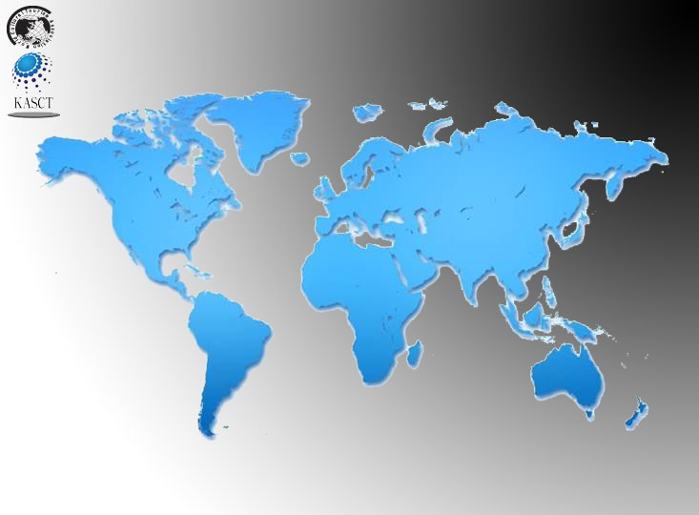
World Cultural Tourism Association
World Tourism Association
The Korean Academic Society of Culture & Tourism
4th World Tourism Conference
18th International Joint World Cultural Tourism Conference
Cultural Tourism: Past and New
DATE : May 20~22, 2016
VENUE : Harris Hotel Bukit Jimbaran, Bali, Indonesia
Organized by
Dut Tan University, Vietnam, University of Novi Sad, Serbia, University of Phayao, Thailand, Istanbul Arel University, Turkey, Tourism College of Zhejiang, China, Cape Breton University, Canada, Ceta University of College of Tourism, Spain, Yasar University of Turkey, University of Hawaii, USA, National Pintung University of Science and Technology, Taiwan, Tumaini University
at Ireinga, Tanzania, South Kazakhstan State University Kazakhstan, Australian School of Tourism and Hotel Management, Australia, School of Hospitality, Tourism & Culture Heritage Institute, Canada, Technological Education Institute of Piraeus, Greece, Philippine Society for Culture and Tourism, The Philippines, The Hokaido Academic Society of Tourism, Japan, Education University of Indonesia, Indonesia, Hanyang Women’s University, Korea, The Korean Academic Society of Culture and Tourism, World Cultural Tourism Association, World Tourism Association

